Slide 1
Can Box Score Data Predict
NBA Games Better Than Vegas?
Building a game forecasting model on 14 seasons of NBA data, and testing it against real betting markets
Panagiotis, Aman
Notes:
The question is simple. We have every box score since 2010. Can we turn that into a model that predicts games better than the sportsbooks do?

Slide 2
What we are working with
GAME DATA
MARKET DATA
THE TARGET
33,316 team game logs covering 2010-11 through 2023-24.
Points, rebounds, assists, steals, blocks, turnovers, shooting splits.
14,471 games after cleaning.
Historical moneyline prices for 13 seasons.
This is what the sportsbook thought each team's chances were, posted before tip-off.
100% match rate to the game data.
Did the home team win?
NBA games cannot end in a draw, so this is a clean binary outcome.
Home teams win 58.5% of the time.
The core idea: how much does a team outperform its opponents?
FEATURE CONSTRUCTION
For every statistic we take the team's value minus its opponent's value in that game, then average across all earlier games in the season. A team averaging +6 rebounds per game is a strong rebounding team regardless of league-wide pace.
We build 25 such features, then subtract the away team's values from the home team's. Each game becomes one row. The current game is never used to predict itself.
Notes:
Raw averages shift as the league changes. Margins over opponents stay comparable across eras, which is why we use them.

Slide 3
Where the data comes from
BOX SCORES
MONEYLINE ODDS
A public GitHub dataset of NBA team game logs, 2010-11 to 2023-24.
Column names and ID formats match the NBA's official stats endpoints, though the repository does not document how it was collected.
Checked against known results: the 2015-16 Warriors come out at 89.0%, matching their 73-9 record.
A SQLite database shipped with a public betting repository, one table per season since 2007-08.
Its collection script scrapes Sportsbook Review, an odds comparison site that archives what each sportsbook posted. FanDuel is the default book.
Sportsbook Review is not a bookmaker. It is a record of prices.
DECODING THE DATES
JOINING THE TWO
Odds rows are stamped like 2014-15-1027.
The first part is the season, the last four digits are month and day. October through December belong to the first year, January through June to the second.
So 2014-15-1027 becomes 27 October 2014, and 2014-15-0611 becomes 11 June 2015.
Matched on game date plus both team abbreviations. Date alone is not unique, since many games share a night, and using both teams guards against reversing home and away.
All 5,368 games across the five core seasons matched, with no missing prices.
One caveat: we could not establish whether these are opening or closing quotes.
Notes:
Two public sources, neither official. The date format is the fiddly part: the season label tells you which calendar year a given month belongs to.

Slide 4
From prediction to decision
A forecast is only useful if it beats the price. The sportsbook posts odds; we convert them to a probability and compare.
WORKED EXAMPLE
THE HURDLE
Lakers at home, moneyline of -150.
That implies a 60% chance of winning.
Our model says 65%. The price looks too generous, so we bet.
If the model said 55%, we skip the game.
Both sides of a bet together imply more than 100%. The excess is the bookmaker's cut.
In our data it is 3.87%.
You must be nearly four points sharper than the book before earning anything.
Four models tested: logistic regression, random forest, SVM, neural network. Two selection criteria: accuracy, and calibration.
ACCURACY VERSUS CALIBRATION
Accuracy asks how often the predicted winner is right. Calibration asks whether the probabilities are honest: among games called 70%, roughly 70% should be won. For betting, calibration is what matters, because the probability is the thing the decision consumes.
Notes:
The betting rule never asks who will win. It asks whether the price is wrong. That distinction drives everything that follows.

Slide 5
The model works, by the usual standards
Model | Accuracy | Calibration error
Logistic regression | 65.3% | 4.31%
Random forest | 65.4% | 5.68%
Neural network | 65.5% | 4.65%
Support vector machine | 66.3% | 4.40%
LOOKS RESPECTABLE
66% accuracy on NBA games is in line with published research, which clusters around 65 to 70%.
Calibration error near 4% means the probabilities are broadly honest.
By normal machine learning standards, this is a working model.
So we ran a full season of betting with it.
Strategy | Final bankroll | Return
Flat $100 per bet | $12,503 | +25.0%
Eighth Kelly staking | $4,489 | -55.1%
ONE SEASON, TWO ANSWERS
The same model and the same bets. Only the stake sizing differs, and the outcome flips from a 25% gain to a 55% loss.
Notes:
A 25% return on one season looks like a success. The Kelly result on identical bets should already make us suspicious.

Slide 6
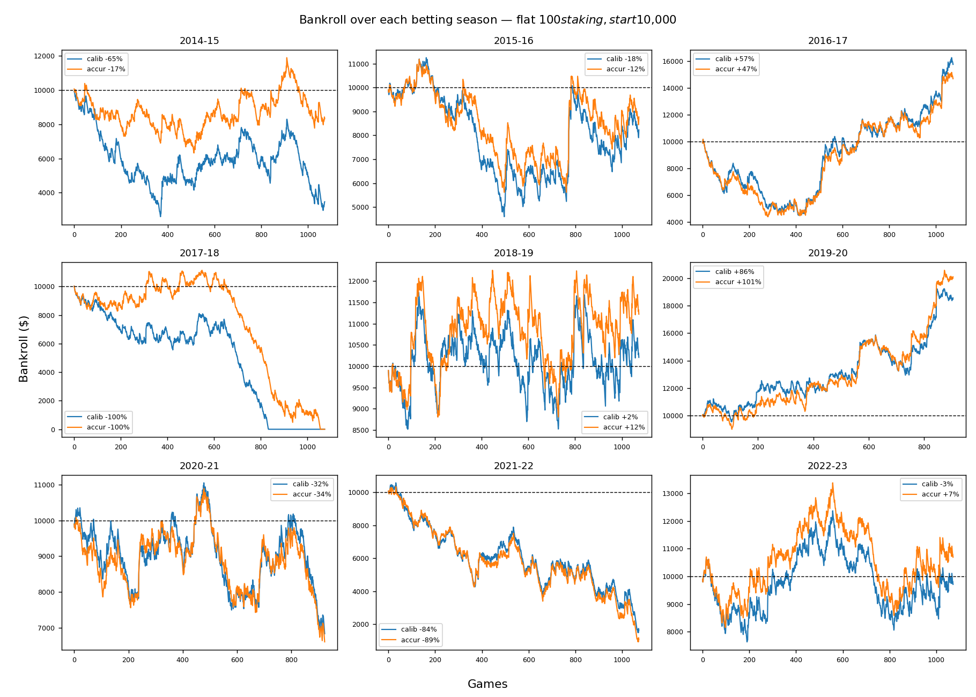
Nine seasons tell a different story
WILD SWINGS
2016-17: up 57%
2019-20: up 86%
2022-23: up 7%
2017-18: bankrupt
2021-22: down 84%
2014-15: down 65%
NO STABLE EDGE
Same code. Same features. Nine different answers.
Average return across all seasons is negative.
The 25% season was not skill. It was one draw.
Notes:
Each panel repeats the whole pipeline from scratch. The spread between best and worst season is over 180 percentage points.

Slide 7
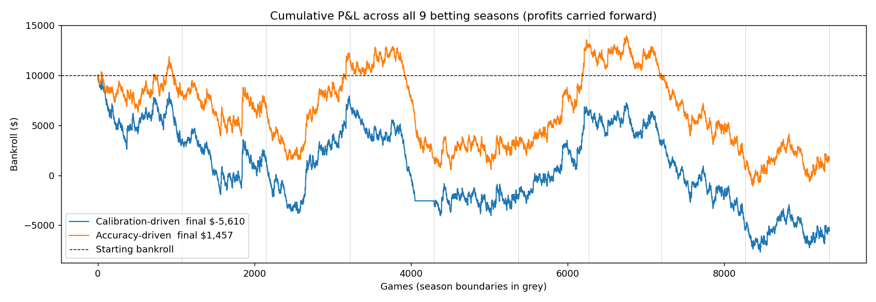
Over 9,400 games, the money drains away
Carrying profits forward across all nine seasons, both strategies end below where they started.
Most bets land on underdogs paying around 4.5 to 1. With roughly 450 such bets a season, one season's return has a standard deviation of plus or minus 43 percentage points. Any single season tells you almost nothing.
Notes:
This is the statistical heart of the talk. A 25% season sits well inside the noise band of a strategy with no edge at all.

Slide 8
Why: the market already knows everything
 | Log loss | Accuracy | Calib. error
Our model | 0.6230 | 64.9% | 15.5%
Sportsbook | 0.5962 | 67.9% | 3.8%
OUR FEATURES ADD NOTHING
Combine our 25 box score features with the market price and predictions get worse in 8 of 9 seasons.
The odds already contain everything the box scores can tell us.
The sportsbook is more accurate and better calibrated, in all 9 of 9 seasons.
WHERE THE WINS CAME FROM
THE ONE REAL SIGNAL
Every profitable season was carried by underdog bets. Every losing season by underdog misses.
Betting underdogs blindly, with no model at all, also gained 42% in 2016-17.
The good years were lucky years, not skilful ones.
Our underdog picks won 23.3% of the time where the book implied 22.0%, an edge of 1.3 points.
Over 3,591 bets the margin of error is 1.4 points, so this does not clear significance.
Confirming it would take about 40 seasons.
Notes:
A model that cannot out-predict the price cannot beat it. This slide is the mechanism behind every result in the deck.

Slide 9
What we learned
THE MODEL IS FINE
THE MARKET IS SHARPER
ONE SEASON PROVES NOTHING
66% accuracy and 4% calibration error match published NBA research.
The failure is not in the modelling.
Vegas beats our model on every metric in every season.
Box scores are public, so the price already reflects them.
Returns swing 180 points across seasons.
Any backtest on a single season is measuring luck.
Beating a market requires information it does not have, not a better model of information it already has.
WHERE AN EDGE COULD STILL EXIST
Injury news, rest patterns and confirmed starting lineups reach the market late, so a model that reacts faster could in principle find value. The honest test is whether forecasts beat the closing line, because realised returns need decades of data to resolve an edge this small.
Notes:
We built a working NBA prediction model, and the most valuable result was learning why it could not make money.

